Slide 1




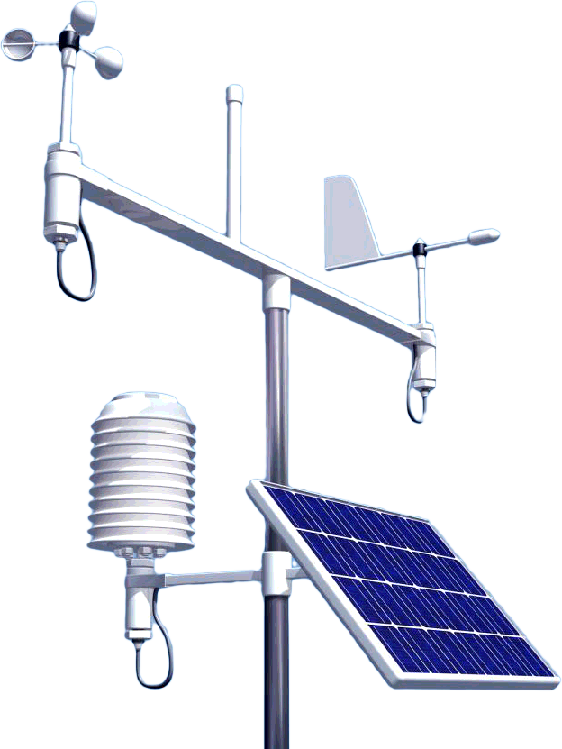

WEATHER STATION DEVELOPMENT:
SENSOR MODULE
DIOGO RIBEIRO, 46307@ALUNOS.ISEL.IPL.PT
ADVISORS ENG. CARLOS JORGE GONÇALVES
& ENG. Pedro Miguens Matutino
Degree in Informatics and Multimedia Engineering (LEIM)
PRJ#05
Notes:
Good night everyone.
Today I am presenting to you my final course project, which is about developing a weather station.
My name is Diogo Ribeiro and the advisors for this project are engineers Carlos Gonçalves and Pedro Miguens.

Slide 2


Introduction
What is it?
Interface capable of:
Connecting to various weather sensors
Interpreting and presenting their data
Notes:
Let’s start by asking, what is it?:
My project involves an amateur weather station plus an interface capable of connecting to various weather sensors and intehrpreting their data.

Slide 3
Introduction
Motivation
Simplify weather science systems
Agriculture, forestry and horticulture
Places of meteorological interest, microclimate
Notes:
The goal is to bring complicated weather science systems down to an individual level to be used within the IoT paradaigm.
The product is mostly applicable to agriculture, forestry and horticulture, as well as general places of meteorological interest.

Slide 4
Goals
Support for any weather sensor (programmed in MicroPython)
Precise assessment of the weather conditions in a small area (ex. greenhouse)
Straightforward installation of the full system and integration with other IoT systems (ex. irrigation system)
Notes:
An effort was made so any weather sensor can be integrated with this system, all thanks to Python's dynamic type checking.
Furthermore, there are plans to predict the short-term weather for the small area covered by the sensors, for example a greenhouse.
Another goal was to make a full system installation straightforward and integrate with other IoT systems, such as an irrigation system.

Slide 5
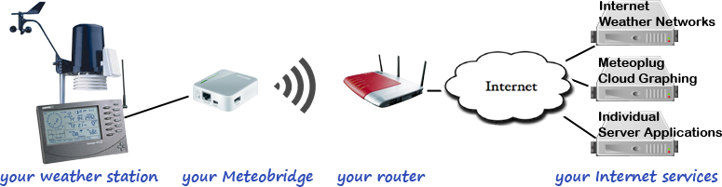
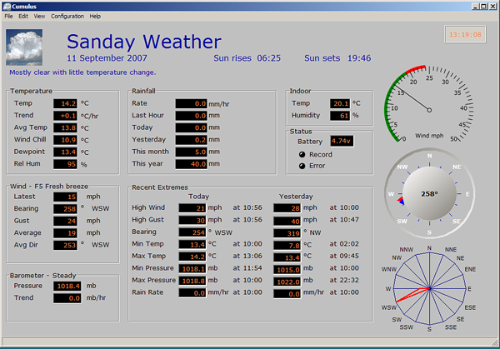
Similar and related Works
Meteobridge
Dedicated to preexisting infrastructure
Cumulus
Depends on professional-grade weather stations
Notes:
Regarding similar works, there are systems on the market built for the same purpose, except they are usually forced to work with a few pre-built weather stations and networks.
Such is the case of Meteobridge, which is sold as a Raspberry Pi-like device to facilitate communication between station and network.
As for Cumulus, it’s software that retrieves and displays data from professional-grade weather stations.

Slide 6
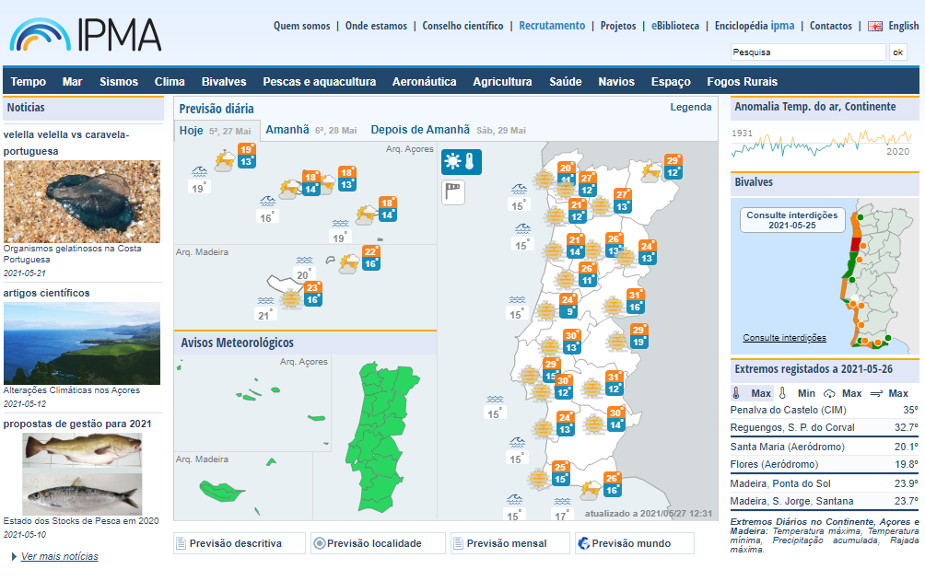
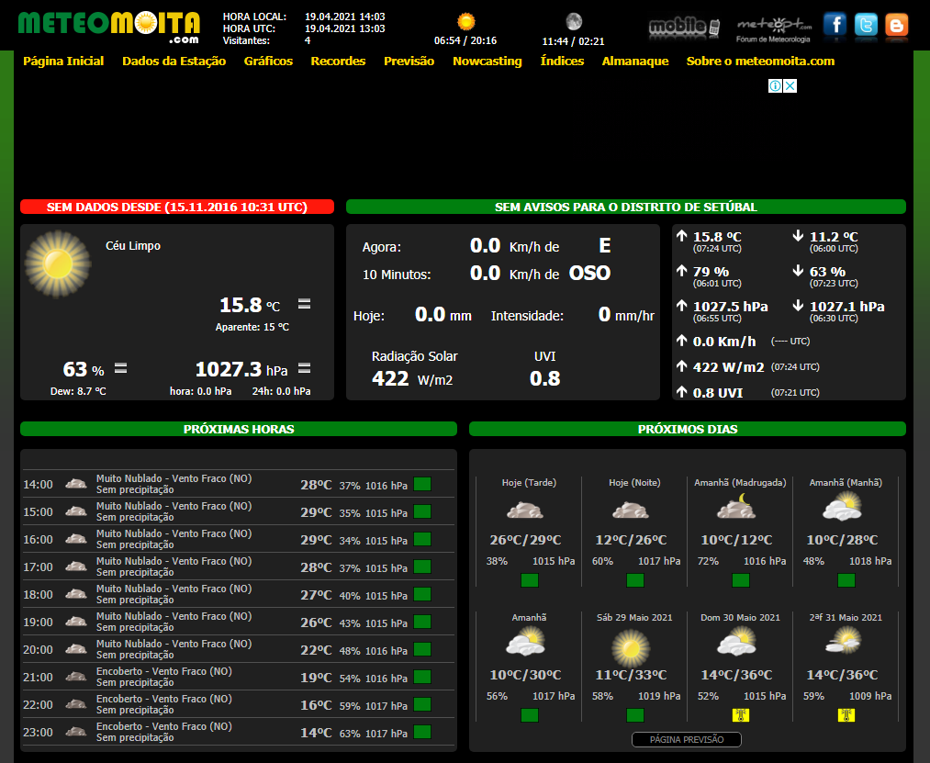
Similar and related Works
IPMA
Official government agency
Highly scientific
MeteoMoita
Uses a paid interface (WXSIM) to predict weather using scientific models
Notes:
The product is supposed to culminate all its data into a weather briefing website inspired on MeteoMoita and IPMA’s.
Also to do the predictions in the most correct way possible, some papers were researched,
namely one published this January from Universidade do Minho where they explore the effectiveness of ARIMA and TBATS models,
as well as a 2018 one from Norway regarding the use of Python for weather forecasting,
and finally an older german paper from 1999 which focuses on mathematical models for short-range and short-term forecasting.
To support my findings, I also traded e-mails with Doctor Stephan Siemen from the European Centre for Medium-Range Weather Forecasts (more on that later).

Slide 7

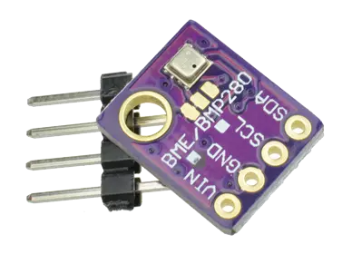
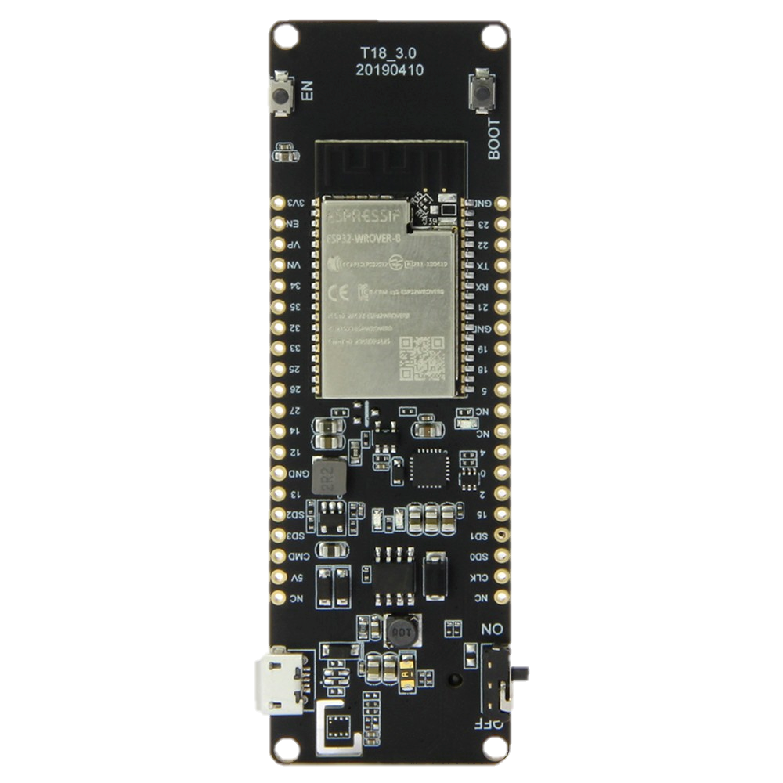


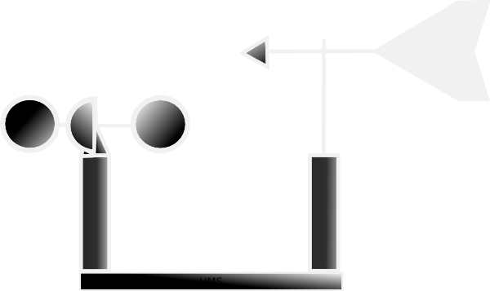
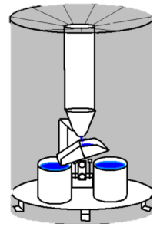

Project Architecture
Notes:
So, moving forward, about the actual system:
this figure shows the architecture from the sensors, through the microprocessor, broker, server (plus the database) and all the way to the web page

Slide 8
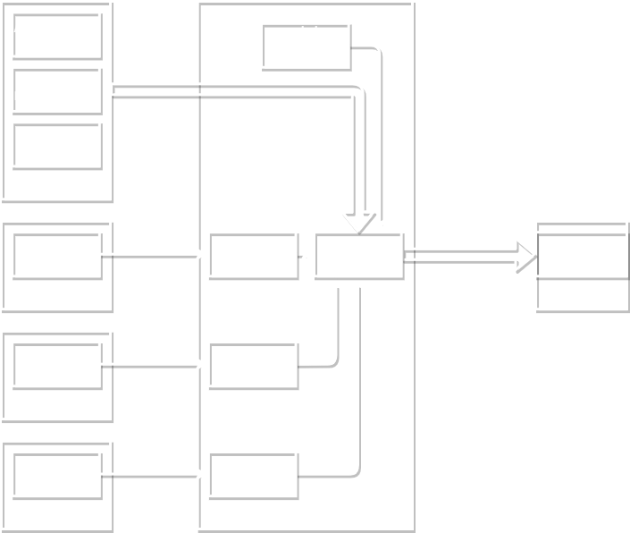
Block Diagram: Sensor Module
Notes:
More in detail here’s a block diagram of the first half of the project.
This diagram shows the data from the sensors being collected into the MQTT client in order to be sent as a JSON object to the broker.

Slide 9
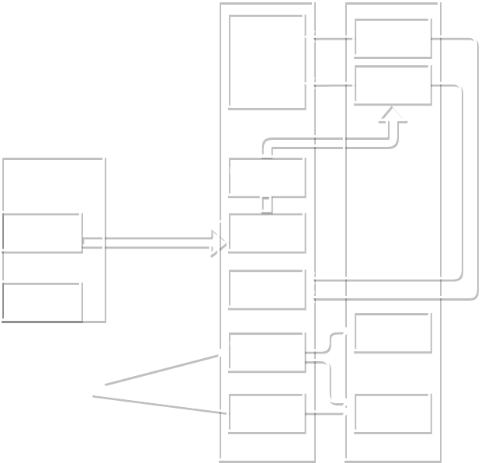
Block Diagram: Weather Server
Station #n
Notes:
The previous graph shrinks to show the latter part of the project, which supports multiple stations.
Upon receiving their data from their MQTT dedicated topics, it processes it and sends to the database.
The data can be then used for the forecast or sent to the web pages. Let’s go into more detail on the parts then:

Slide 10
Weather Sensors
BME280 (I₂C)
Temperature (-40 to 85±0.01 °C)
Relative humidity (0 to 100±0.008 %RH)
Atmospheric pressure (300 to 1100±0.0018 hPa)
Anemometer + Weathervane
Wind velocity
Wind direction
Rain gauge (also known as pluviometer)
Rain intensity
More!
Notes:
There are three (technically four) sensors involved currently:
BME280 uses I2C to report temperature, humidity and pressure, and there’s a custom-made anemometer and rain gauge.

Slide 11
Microcontroller
LILYGO® TTGO T-Energy ESP32 Development Board (T18_3.0 20190410)
Based on ESP32-WROVER-B (developed by Espressif Systems)
Wi-Fi functionality 802.11 b/g/n/e/i up to 150 Mbps
4MB Flash / 8MB PSRAM
520 kB SRAM
Working voltage 2.3V-3.6V
3.7V lithium-ion rechargeable battery (18650)
Notes:
The microcontroller used is based on the popular ESP32 model.
To answer the system’s needs, it can run on battery, has Wi-Fi functionality and decent memory to load and run some MicroPython programs.
It also has many power saving features, that weren’t focused on in this project, but are in an analogous one from the LEIC course.

Slide 12

MicroPython
Alternative to programming with the Arduino IDE in C++
Full Python compiler and runtime that runs on the microcontroller's hardware
Interactive prompt (the REPL) to execute supported commands immediately
MicroPython includes modules which give the programmer access to low-level hardware
The project makes full use of the pros of Python, namely built-in data structures, increased readability, dynamic typing, Garbage Collection support, etc.
Python is prioritized as the main language on the project’s backend
Notes:
There were many advantages found in using Python, more precisely MicroPython, to develop on the ESP32 board.
These include a console you can program from directly through SSH, dynamic typing, its ease of use and readability.
There’s an alternative on the rise called CircuitPython:
It wasn’t considered simply because I already had MicroPython installed on the board.
I didn’t want to bother with the risks of switching even if it meant a small upgrade.

Slide 13

MicroPython
Notes:
This is a small class diagram of the software developed for the microcontroller.
You instantiate a Station object and call “set data source” which associates a tag with a getter function or property.
That way, when “compile” is called, all the functions stored in the dictionary are called and stored on a JSON object.

Slide 14


Mqtt Broker
Notes:
After passing through the MQTT tunnel we arrive at…

Slide 15

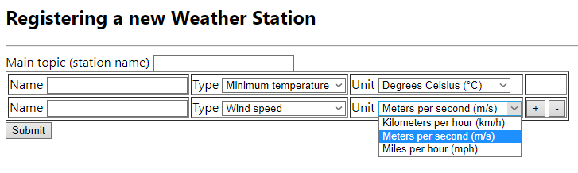

What is left to be done… Web Server
Configuration pages for adding new stations or changing active ones
Notes:
…what’s left to be done: the web server.
Until now I’ve developed a prototype of the page used to register a new weather station and its topics to the server.
The web server will be developed using Flask, which is a simple Python web framework.
Flask was chosen over Django mostly because I was planning to have a RESTful API but, since I am not deep into development, I might consider the switch.
Out of Flask I’ve put to work a Hello World web page and a connection to the database using SQLAlchemy.

Slide 16
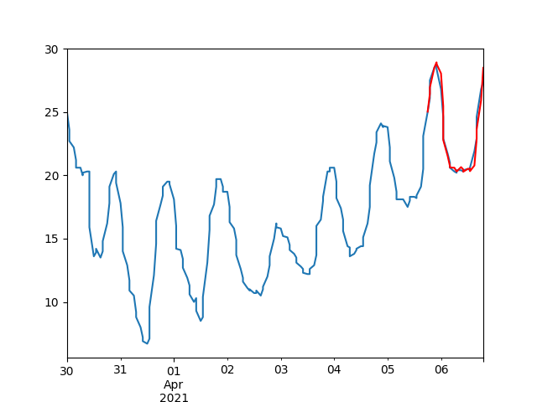
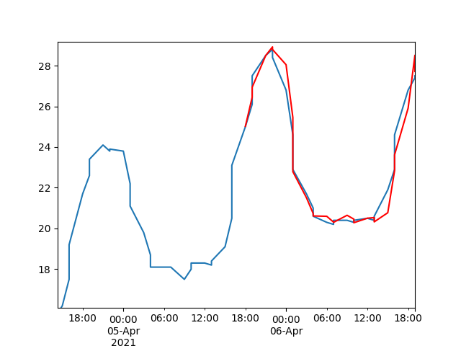
Arima Model Weather Forecast
The last day of a week was used as test subset:
Red represents the predicted values and blue the known values.
(data displayed is from Austin, Texas)
Notes:
So, what we’re seeing here in red are some attempts I’ve made at predicting the average temperature for 24 hours using the previous 6 days as a sample. I also kept the actual temperature for reference, represented by the blue line beneath the red.
On the right side you see a zoom in of the last two days of the week displayed on the left graph.
In this test case I used a dataset made available by the US National Climatic Data Center. I cleaned up the data manually into a comma-separated values file and these are the results.
My conclusion was that they were not bad at all considering the range applied, but I must make more tests with more data to check on the grand scheme of things.
As was advised by Doctor Stephan Siemen from ECMWF, I will get the longest time series of data I can from an already functioning local station.
There is also the long-term option of waiting to collect a big volume of data from this station, but it could take many years for a good result.

Slide 17


PostgreSQL Database
For an accurate forecast, the more data the better
PostgreSQL is relational and has great performance.
Notes:
The database tables are designed to support user authentication and event subscription by said users,
as well as the chain starting from full station to individual topic unit to harbor the weather data.
Given the connection between these systems, the database should be relational.
PostgreSQL was chosen because it supports bigger volumes of data than MySQL, which is what Is necessary for the most accurate prediction possible.

Slide 18
Project Schedule and Progress
Communicating from MicroPython Station class with MQTT
Receiving MQTT data in server from station
Develop the events system for notifications
Data cleaning and processing, setting up the database
Inserting data into the database
Developing a forecast based on stored data
Developing web pages to show the data
Assembling the ESP32 electronic circuit
Programming MicroPython libraries for sensors
Developing web pages to configure the station
End of April
Start of May
End of May
Start of June
Notes:
Here’s a graph that shows the development status of the project:
Keep in mind that in between these completed fields I have developed all the planning and a big chunk of the final report.
Hopefully these last six topics will pick up pace in the next weeks.

Slide 19

Questions?
Notes:
…And that’s all from me. Thank you for attending FEIM until the end. Any questions?

Slide 20
MicroPython
Connection to the REPL previously mentioned can be achieved via Serial Port, with 115200 BAUD (software used was PuTTY)
Using the Python library adafruit-ampy on desktop (add to PATH environment variable) allows for file manipulation on the board’s file system via command prompt.
“Send file to ESP32.bat” example: ampy --port COM3 put %1

Slide 21
Functional Requirements
Ref. | Function | Category | Attribute | Detail | Category
1 | Reading and interpretation of the weather sensors | Invisible | Flexibility | Implementation of as many units of measurement as possible | Mandatory
2 | Sending data to the MQTT broker | Invisible | Fault tolerance | Emphasis on the robustness of MQTT messages | Mandatory
3 | Cleaning and analysis of the data received from the sensors | Apparent | Reliability | Must be available to receive broker data whenever possible | Mandatory
4 | Collection and processing of historical weather data | Invisible | Modular | Development of a Web server that uses a database with an API | Mandatory
5 | Recent local weather forecasts | Apparent | Correctness | Concern with approaching a scientific model | Desirable
6 | Graphic representation of accumulated historical data | Decorative | Human-Machine Interaction | Availability of the collected information on web pages | Desirable

